Slide 1
Exercise 1
Exercise #1
Modify the cities table in the pandas ipython notebook by adding a new boolean column that is True if and only if both of the following are True:
The city is named after a saint.
The city has an area greater than 50 square miles.
Note: Boolean Series are combined using the bitwise, rather than the traditional boolean, operators. For example, when performing logical and, use & instead of and.
Hint: "San" in Spanish means "saint."

Slide 2
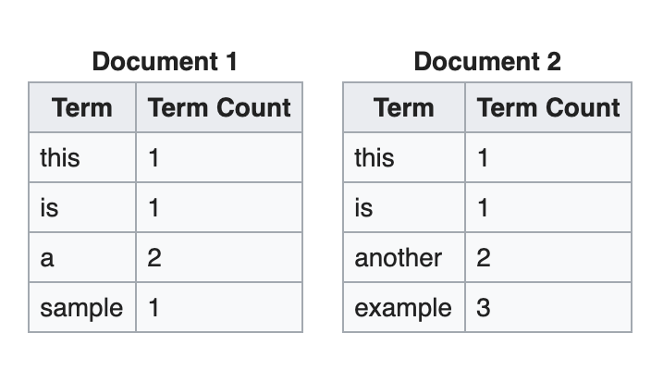
Exercise 2
Create 2 dataframes in pandas based on the information below and calculate tf-idf score for each word in document d1 and d2. The function you try to design is tfidf(w,d) where w can be any word in the vocabulary and d is either d1 and d2.

Slide 3
Exercise 3
Run eigenfaces.py
Change the number of principal components to 200, 250 and 500. Explain the changes you observe in the reconstructed output.
Read the PCA class/function in sklearn and tell the TAs the methods sklearn uses to find the eigenvectors and eigenvalues.
Fill in the blank: in PCA, given data matrix X of shape n*d where n is the number of data points and d is the dimension of the data, we calculate eigenvectors and eigenvalues of M which is ________ of X.
X is the input matrix with shape n*d where n is the number of data points and d is the dimension of the data. Lets assume Cov(X) = A^{T}A and A = f(X). Find the function f to apply on X that gives you A. Cov(X) is the covariance matrix of X.
Why do we sort eigenvalues and select eigenvectors in the decreasing order of eigenvalues.

Slide 4
Exercise 4
Assume we need to create a model that predicts the number of customers at a restaurant at any point of time. What kind of features should we extract?

